Slide 1
Implementasi Struktur Data topological sort shortest path
Program Studi Diploma III Teknik Informatika
Fakultas Ilmu Terapan
Universitas Telkom

Slide 2
Topological Sort
A topological sort of a dag (directed acyclic graph) G = (V, E) is a linear ordering of all its vertices such that if G contains an edge (u, v), then u appears before v in the ordering. Not acyclic → no linear ordering is possible
Because the graph has no cycles:
There exists a vertex u in G such that u has no predecessor.
There exists a vertex v in G such that v has no successor.
Topological sort of a graph can be viewed as an ordering of its vertices along a horizontal line so that all directed edges go from left to right

Slide 3
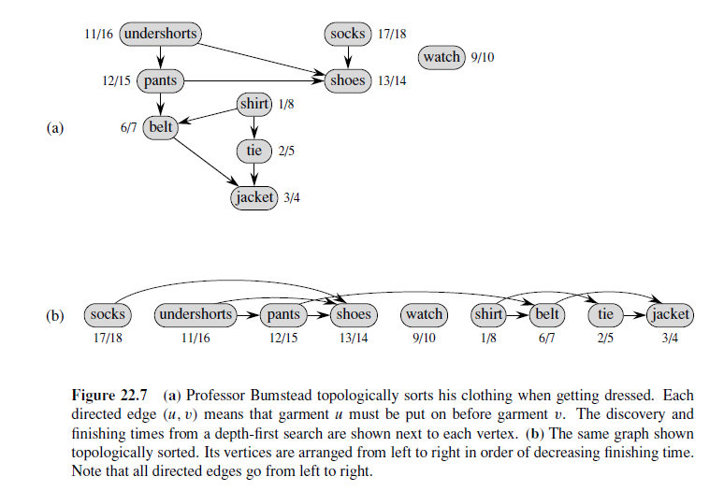
Topological Sort

Slide 4
Topological Sort
Number vertices, so that (u,v) in E implies u < v
wake up
1
A typical student day
2
3
eat
study computer sci.
4
5
nap
more c.s.
7
play
8
write c.s. program
6
9
work out
make cookies for professors
10
sleep
11
dream about graphs

Slide 5
algoritma
Menggunakan DFS
Menggunakan BFS
Temukan vertex dengan InDegree = 0 →tidak memiliki predecessor
Print vertex
Hapus vertex tersebut serta edgenya

Slide 6
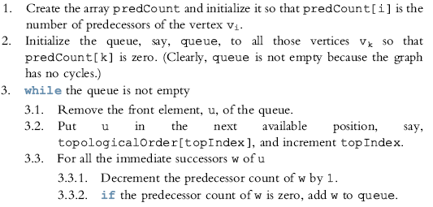
algoritma

Slide 7
algoritma
Proses secara umum :
Array indegree diisi dengan nilai indegree tiap vertex
Untuk vertex-vertex dengan indegree = 0, masukkan ke queue
While queue is not empty, sebuah vertex v dihapus dari queue dan semua edge yang adjacent (berisisan) dengan vertex v diturunkan satu nilainya (Indegree(w) = Indegree – 1, dengan w adalah vertex yang berhubungan dengan vertex v)

Slide 8
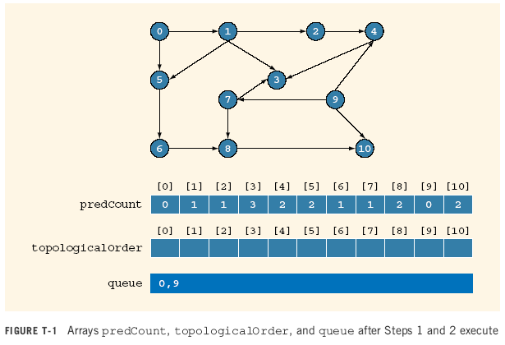

Slide 9
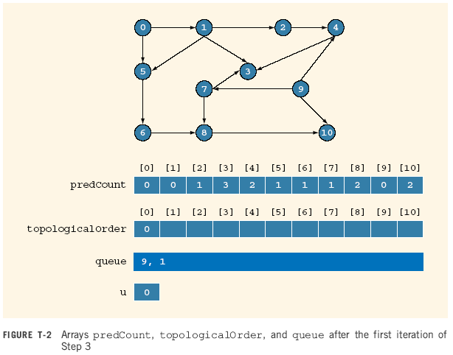

Slide 10


Slide 11


Slide 12
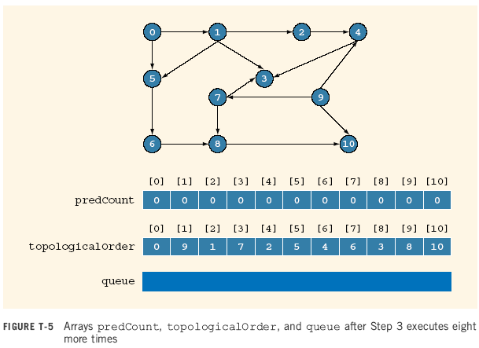

Slide 13
Shortest path

Slide 14
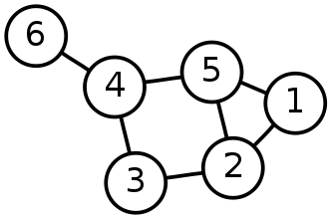
Single-Source Shortest Path Problem
Single-Source Shortest Path Problem - The problem of finding shortest paths from a source vertex v to all other vertices in the graph.

Slide 15
Dijkstra's algorithm
Dijkstra's algorithm - is a solution to the single-source shortest path problem in graph theory.
Works on both directed and undirected graphs. However, all edges must have nonnegative weights.
Approach: Greedy
Input: Weighted graph G={E,V} and source vertex v∈V, such that all edge weights are nonnegative
Output: Lengths of shortest paths (or the shortest paths themselves) from a given source vertex v∈V to all other vertices

Slide 16
Length of weighted graph
Let G be a weighted graph. The length (or weight) of a path is the sum of the weights of the edges of P. That is, if P = ((v0,v1), (v1,v2), . . . , (vk−1,vk)), then the length of P, denoted w(P), is defined as
The distance from a vertex u to a vertex v in G, denoted d(u,v), is the length of a minimum-length path (also called shortest path) from u to v, if such a path exists.
People often use the convention that d(u,v) =∞ if there is no path at all from u to v in G.

Slide 17
Dijkstra algorithm
Dijkstra Algorithm: greedy-method pattern for single-source shortest path problem.
Perform a “weighted” breadth-first search starting at the source vertex s.
In particular, we can use the greedy method to develop an algorithm that iteratively grows a “cloud” of vertices out of s, with the vertices entering the cloud in order of their distances from s.
Thus, in each iteration, the next vertex chosen is the vertex outside the cloud that is closest to s.
The algorithm terminates when no more vertices are outside the cloud (or when those outside the cloud are not connected to those within the cloud)
At which point we have a shortest path from s to every vertex of G that is reachable from s.

Slide 18
Algorithm ShortestPath(G, s): Input: A directed or undirected graph G with nonnegative edge weights, and a distinguished vertex s of G. Output: The length of a shortest path from s to v for each vertex v of G. Initialize D[s] = 0 and D[v] = ∞for each vertex v 6= s. Let a priority queue Q contain all the vertices of G using the D labels as keys. while Q is not empty do {pull a new vertex u into the cloud} u = value returned by Q.removeMin( ) for each edge (u,v) such that v is in Q do {perform the relaxation procedure on edge (u,v)} if D[u]+w(u,v) < D[v] then D[v] = D[u]+w(u,v) Change the key of vertex v in Q to D[v]. return the label D[v] of each vertex v

Slide 19
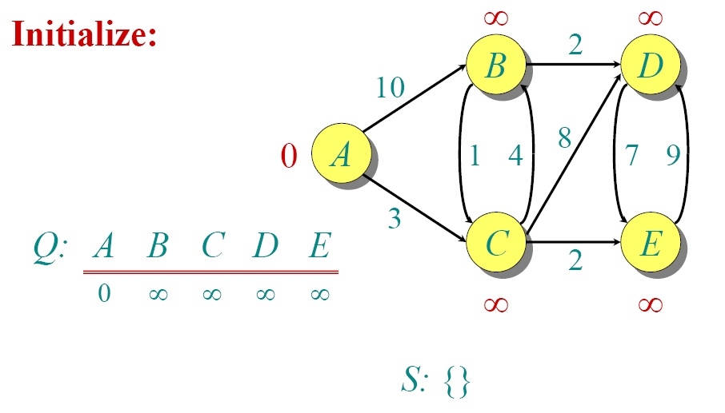
Dijkstra Animated Example

Slide 20
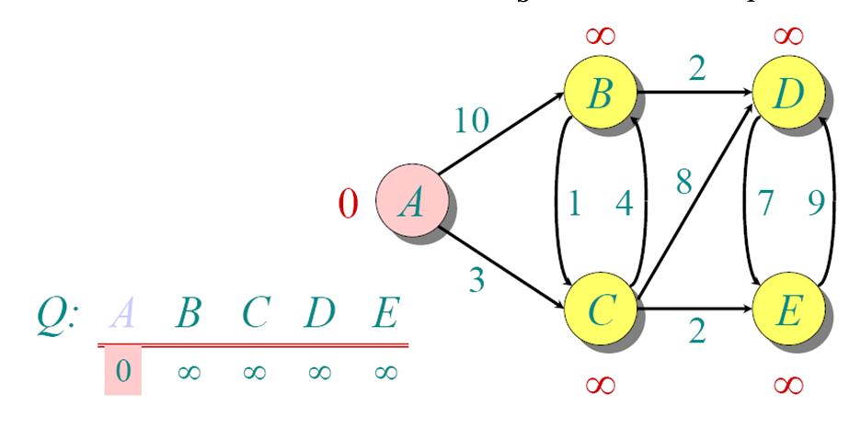
Dijkstra Animated Example

Slide 21
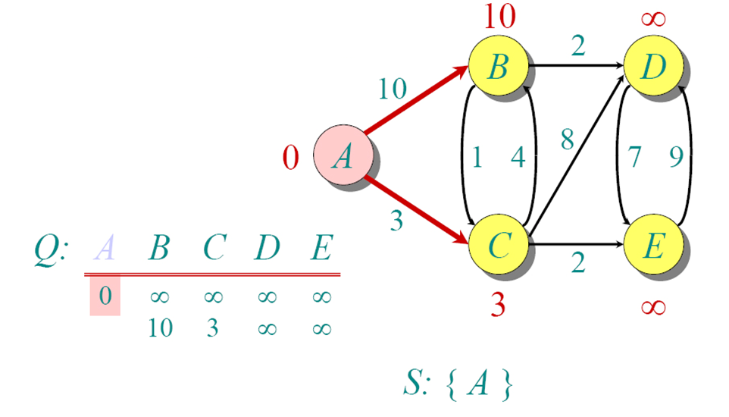
Dijkstra Animated Example

Slide 22
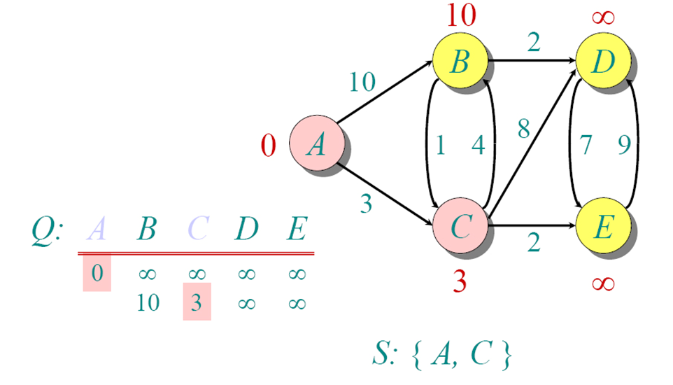
Dijkstra Animated Example

Slide 23
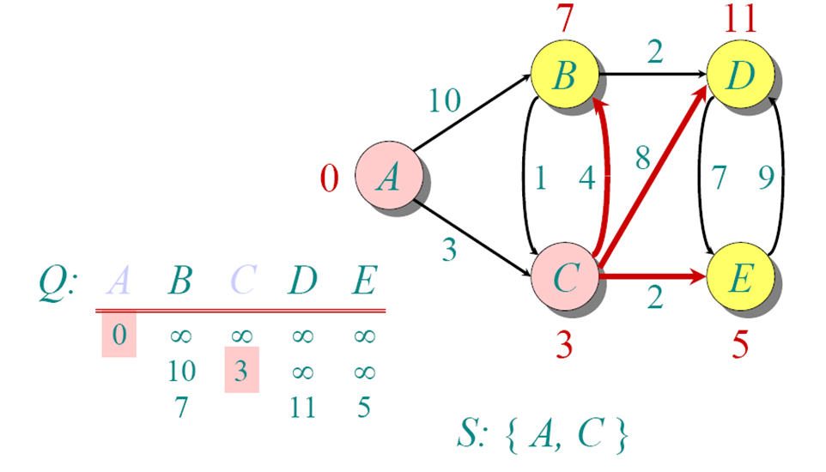
Dijkstra Animated Example

Slide 24
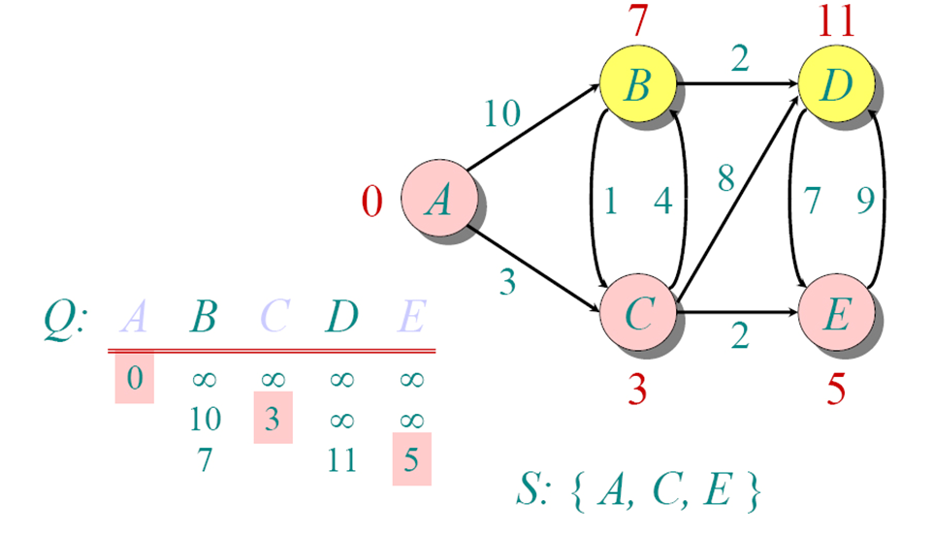
Dijkstra Animated Example

Slide 25
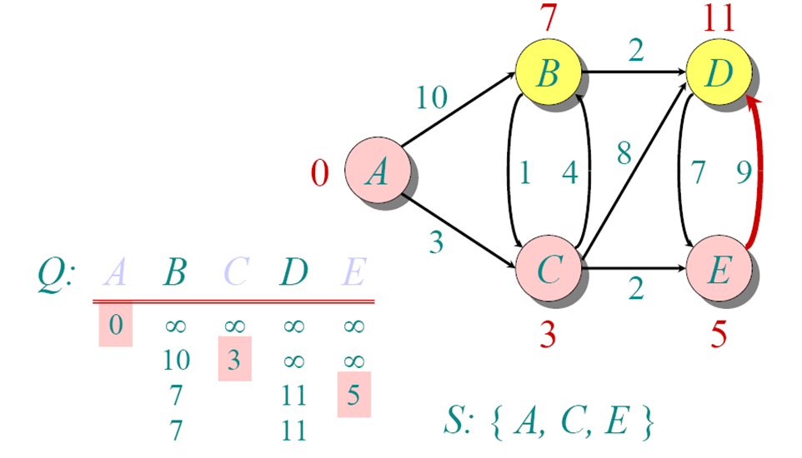
Dijkstra Animated Example

Slide 26
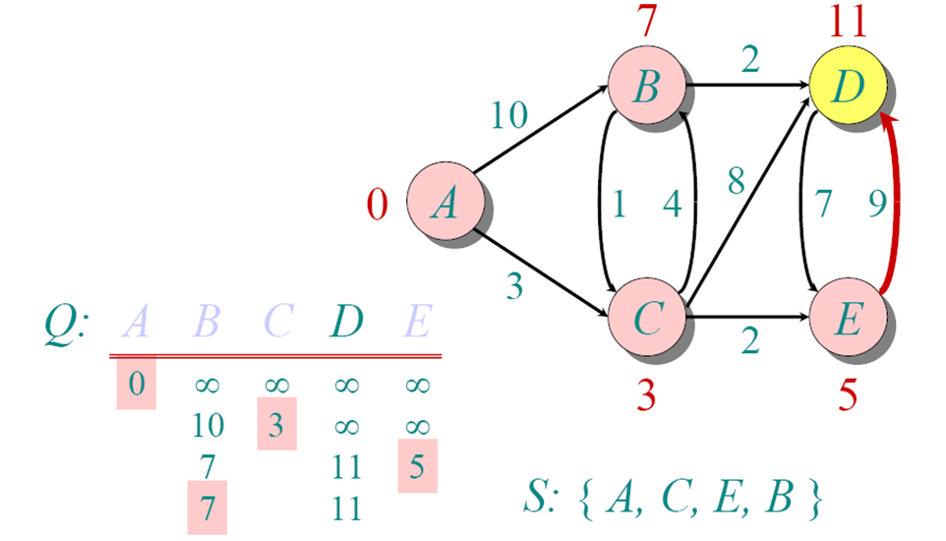
Dijkstra Animated Example

Slide 27
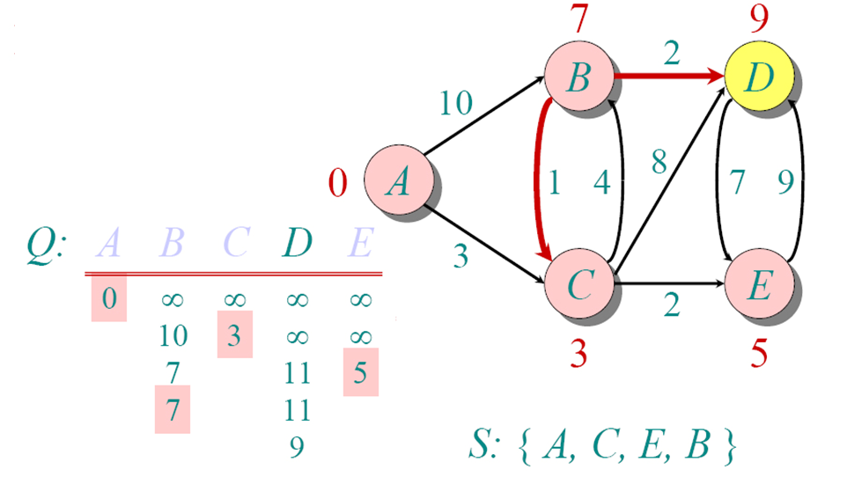
Dijkstra Animated Example

Slide 28
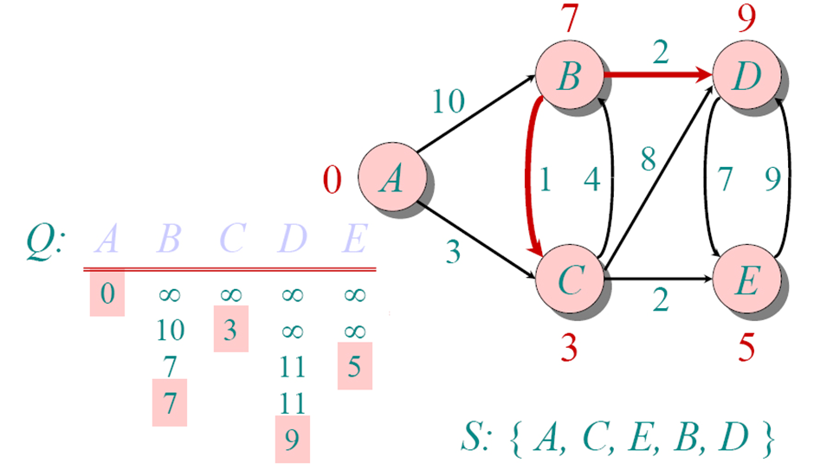
Dijkstra Animated Example

Slide 29
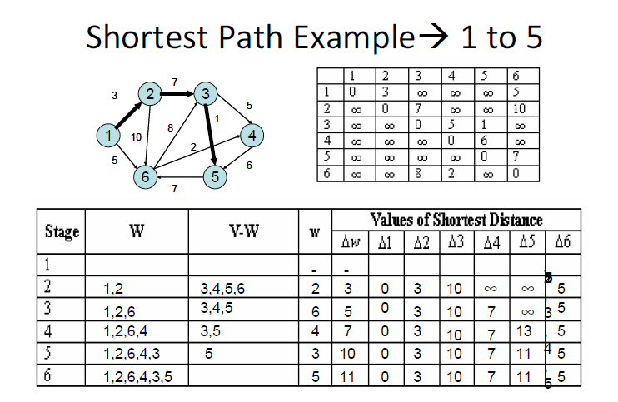
Execution of Dijkstra’s algorithm – Another Representation

Slide 30
References
C++ Programming: Program Design Including Data Structures, 3rd Edition, Ch 21 lecture slide
Carrano, F., M., Lectures Graphs. Data Structures and Abstraction With Java, Prentice Hall, 2012
Cormen, T.H et all, “Introduction to Algorithms”, 2nd edition, Mc-Graw Hill Book, 2001
Lectures PI1043 – Struktur Data, “Graph Data Structure”.
Denny, “Struktur Data & Algoritme – Graphs”, Fakultas Ilmu Komputer Universitas Indonesia 2001
Michelle Wang, Lecture Slide TAT ’01, “Shortest Path Problems-Dijkstra’s Algorithm”.
Lecture slide, “Dijkstra Algorithm: Finding shortest paths in order”
Endang Purnomo Giri, “Graf”, Diploma IPB

